Slide 1
Many Innovation Neat Arrangement Maximum Improvement

Slide 2
ABOUT US

Slide 3
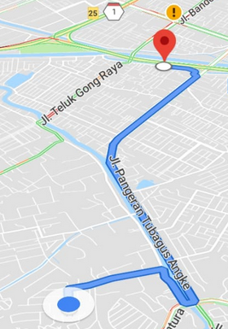
Our Company
Established date 10 March 2006
Current location Pergudangan Prima Center 1 Blok D32
Jl. Pool PPD Pesing Poglar, Jakarta Barat
Telephone 6221 – 2252 0688
Fax 6221 – 2967 1419
Director Lisa Irawati Gunawan
Advisor Shioda Hiroyuki
Manpower 30 persons
Service General Trading & Develop Product
Distance 3 KM (MINAMI – Toll Gate)
Vision
We have high commitment with customer’s satisfaction with Quality, Cost, Delivery and Service (QCDS)
Mission
Growing together with customer and supplier

Slide 4
CUSTOMERS

Slide 5
Type of Customers
Automotive
many more..

Slide 6
Type of Customers
Pharmaceutical
Logistic
Chemical
Food
Construction
many more..

Slide 7
Our Customer
Others
TUNAS MITRA SUKSES
many more..

Slide 8
PRODUCTS

Slide 9
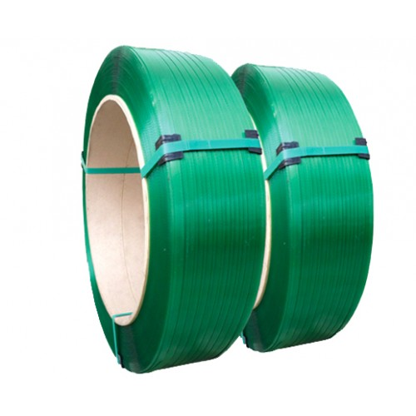
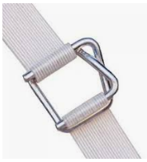
Part of product that we can supply
Stretch Film
Machine Roll
Hand Roll
Strapping band
Strapping band PET
Strapping band PP
Cord Strap
Buckle
Lashing Belt

Slide 10
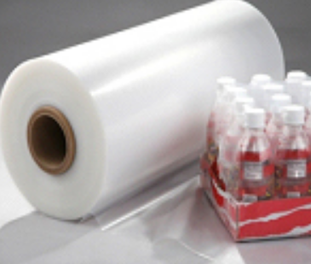
Part of product that we can supply
Partnership with BP PLASTICS HOLDING BHD. (Malaysia)
PE Collation Shrink Film

Slide 11
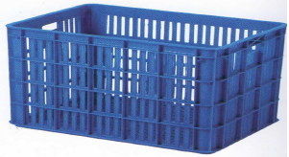
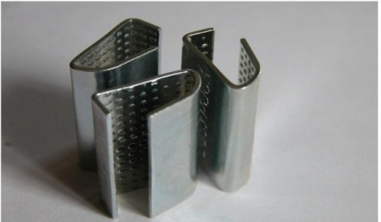
Part of product that we can supply
Locker for strapping band
Plastic Container
Plastic transparan locker
Locker steel
Dimension: 840 x 630 x 375
Dimension: 680 x 490 x 390
Pallet
Paper Pallet
Pressed Pallet
Galvanized Pallet
Plastic Pallet

Slide 12
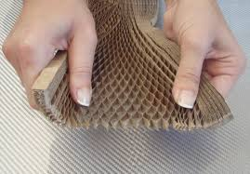
Part of product that we can supply
HoneyComb paper
Honey Pack
Honeycomb
Edge Protector
Edge Protector

Slide 13
Part of product that we can supply
Paper
White Paper
Brown Craft Paper
Laminated Paper
A4 & F4
Recycle Paper A4 & F4
Plastic
LDPE
HDPE
Gusset Perforated

Slide 14
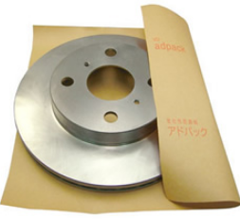
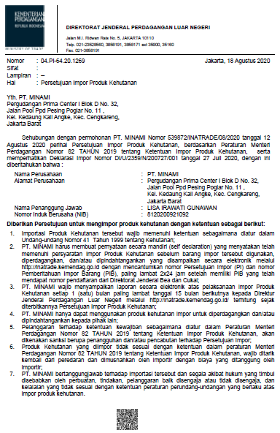
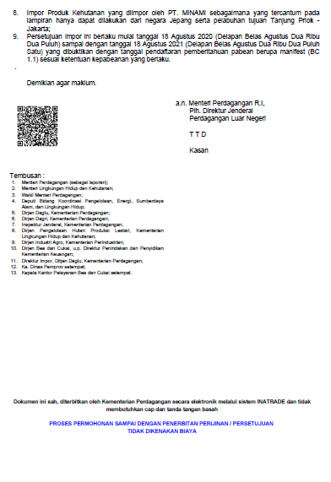
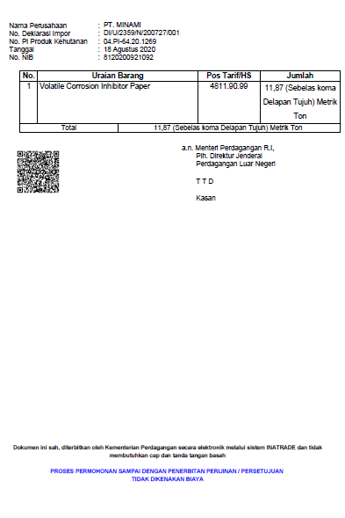
Part of product that we can supply
Anti-Corrosion (VCI Paper)
AGKT
ASK

Slide 15
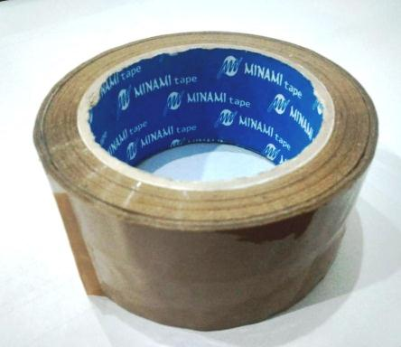
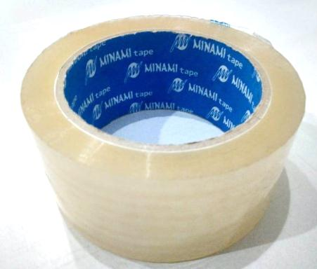
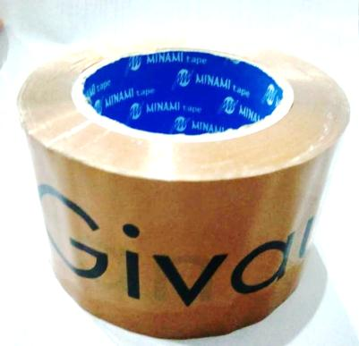
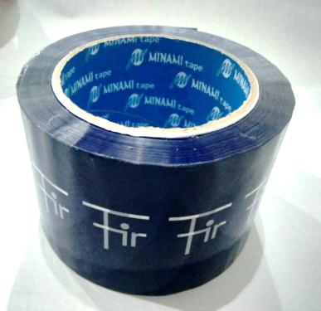
Part of product that we can supply
Minami Tape
Tape OPP (Tan)
Tape OPP (Transparent)
Tape OPP
(Printed - Givaudan)
Tape OPP
(Printed - Firmenich)
many more..

Slide 16
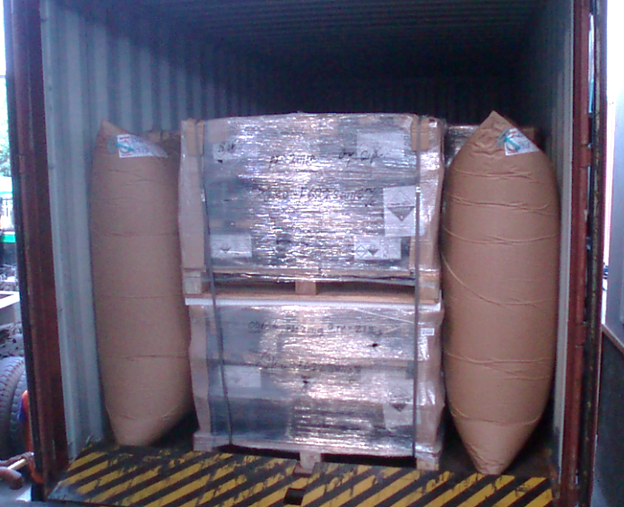
Part of product that we can supply
Air bag
Bundle Wrap
Spec Air Bag :
Uk 600 X 900, ( 2 Ply)
1000 X 1200, ( 2 Ply)
X 1800, (1 Ply)
1000 X 2200 (1 Ply)

Slide 17
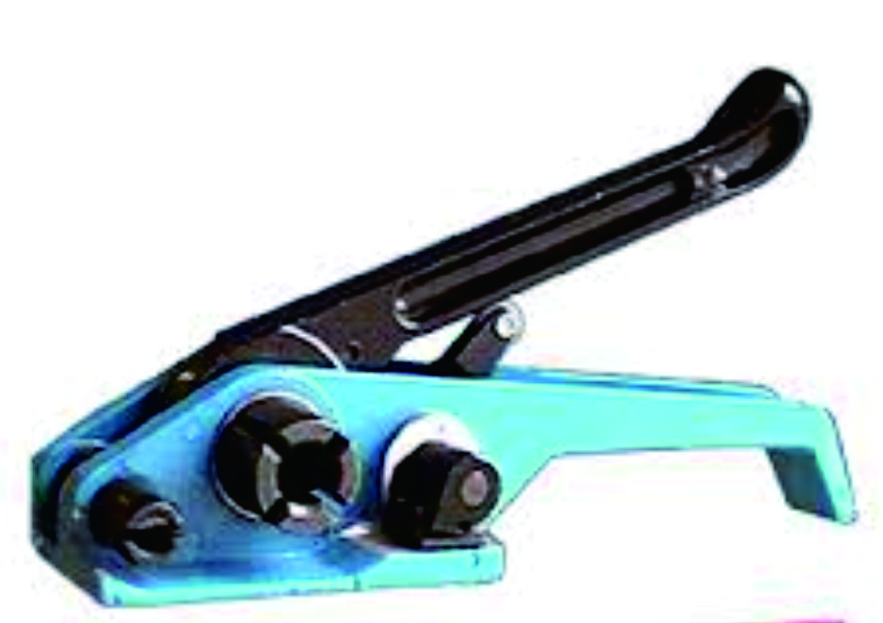
Part of product that we can supply
Strapping Band Tensioner
Strapping Band Dispenser
Tensioner
Dispenser
..... And so on
All product above, equipped with all necessary document such as ROHs, MSDS, SGS, and we assure you that what we supply is in accordance with the quality and specification of your order

Slide 18
CONCLUSION

Slide 19
Conclusion
With our vision, we are using a proactive approach such as :
Excellence Quality, Cost, Delivery and Service (QCDS)
Customize design in size and material for customer needs
No minimum order quantity
24 hours delivery services
Guaranteed product specification
We make adequate provision for the health and safety of our employees, customers and other
Result oriented to serve customer that has been our foundation for over one decade

Slide 20
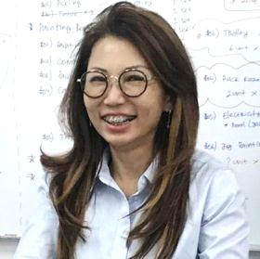
Profile
Currently the business has been supply for more than 100 companies in Indonesia (90% foreign company). Born in Semarang in 1967. Graduated from Satya Wacana Christian University, Economic Faculty, majoring in Finance & Accounting Management in 1990 & Master Degree in Corporate Finance from Prasetya Mulya Business School in 1995.
Lisa Irawati Gunawan
Start her own business on 2006 of trading, assembly & customize products based on customer’s needs in Jakarta.
In 2018, establish a new company, HIGASHI Indonesia (One Stop Spool Repair & Integrated Warehouse Management).

